Slide 1
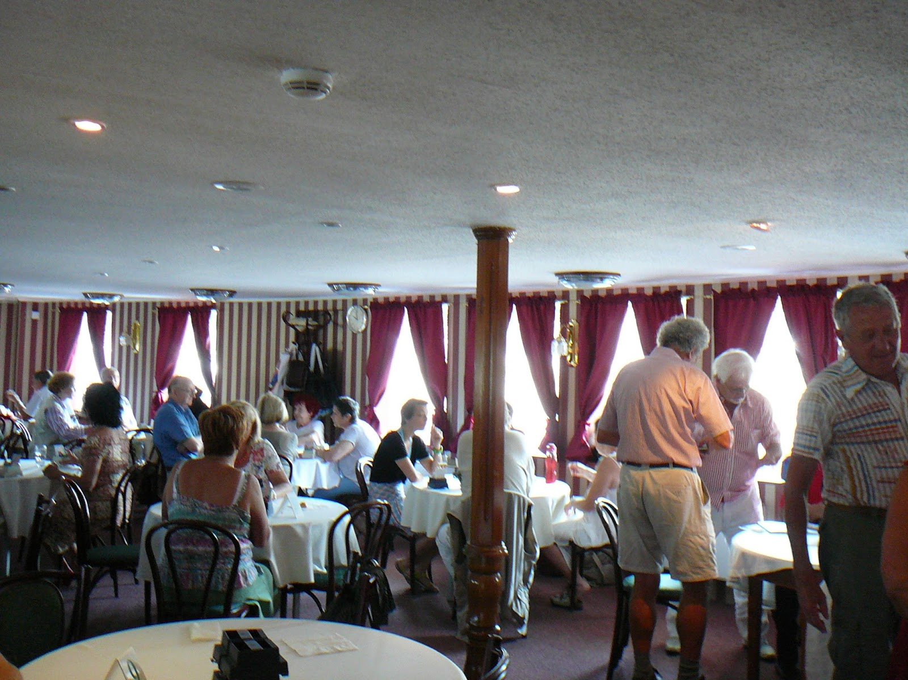
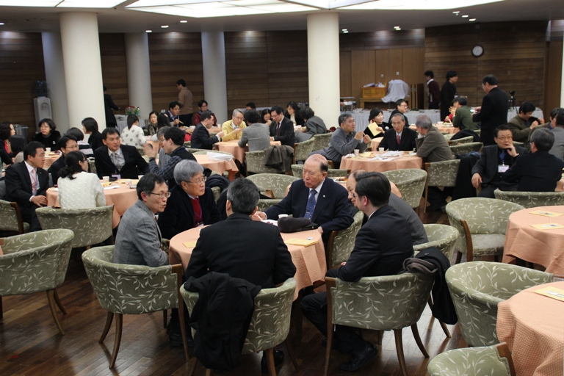
You’re at a restaurant
Notes:
We’ve all had this frustrating experience before.

Slide 2

Waiter …
Notes:
We’ve all had this frustrating experience before.
You’re at a restaurant at dinner time, a peak period.
You want to make an order, so you try wave around to get the attention of a waiter. But the waiters are all busy, so nobody responds to you.
So there you are throwing your hands around. Finally after 10 minutes the waiter comes to take your order.
But before he can pass your order to the kitchen, he has to attend to someone else. And then another person. And another person.
So it takes a full 20 minutes before your first dish arrives and you realize you can’t eat it because you have a peanut allergy are there are peanuts in the dish.
The same problem happens when you want to request for water, or ask for the bill. You keep having to wait and face frustration.
So we made an app to address this problem and change our dining experience for the better.

Slide 3
Waiter … …
Notes:
But the waiters are all busy, so nobody responds to you.
So there you are throwing your hands around.

Slide 4
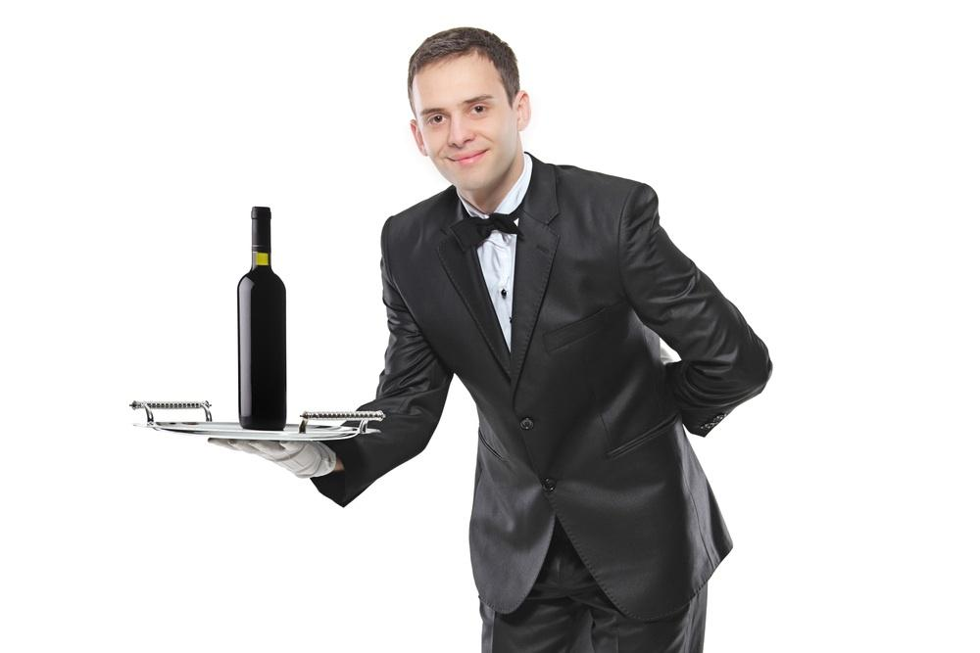
… … …
Notes:
Finally after 10 minutes the waiter comes to take your order.
But before he can pass your order to the kitchen,

Slide 5



Notes:
he has to attend to someone else.

Slide 6
Notes:
And then another person.

Slide 7
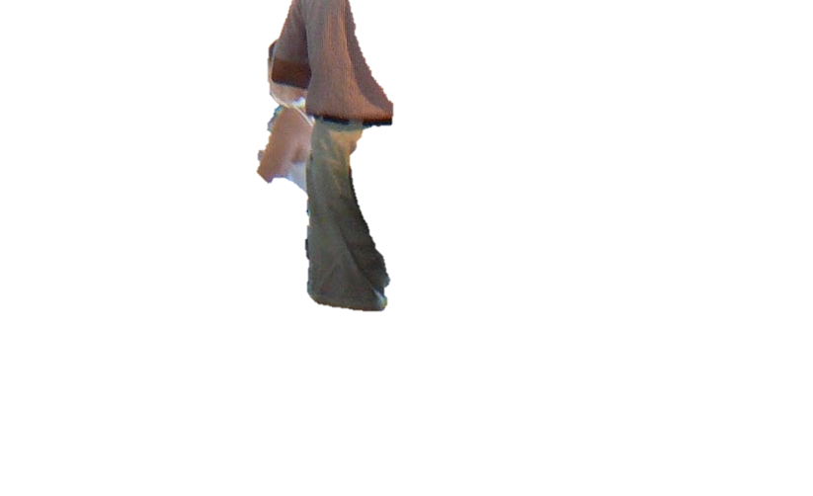
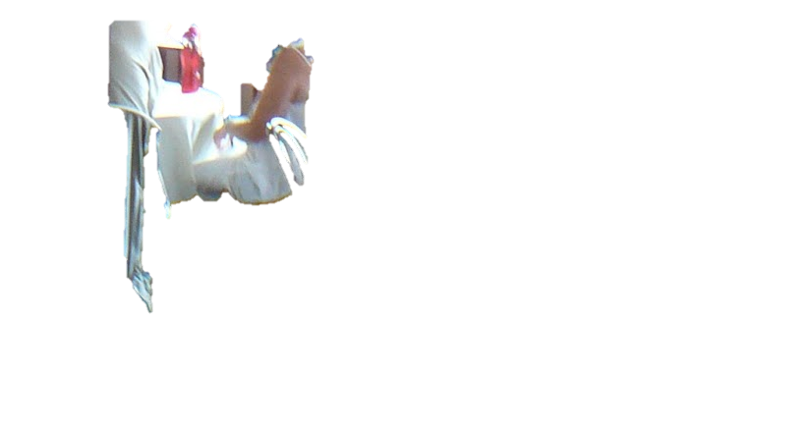
Notes:
And another person.

Slide 8

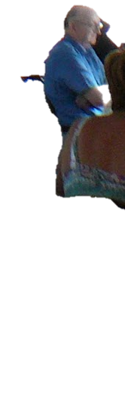
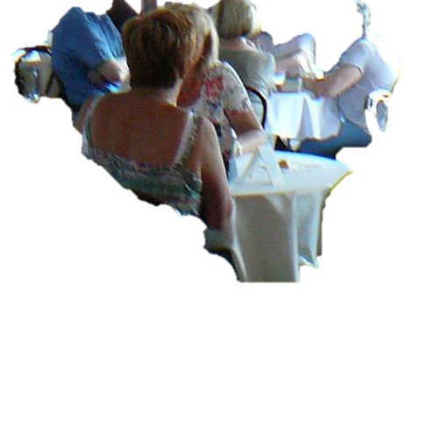
Notes:
So it takes a full 20 minutes before your first dish arrives and you realize you can’t eat it because you have a peanut allergy are there are peanuts in the dish.

Slide 9

Notes:
The same problem happens when you want to request for water, or ask for the bill. You keep having to wait and face frustration.
So we made an app to address this problem and change our dining experience for the better.

